Slide 1
Blog template
Taught by Yossef Ayman Zedan

Slide 2

Navbar
As we can see in the image below, we have a navbar with a navbar brand and a list.
We will copy the navbar: https://getbootstrap.com/docs/5.1/components/navbar/#supported-content
We will delete the form and Keep the list item “link” and “Home”
Let’s talk about the navbar-brand.
We will add <a class="navbar-brand" href="#"> <svg> Your Name
We have the list on the right side. We can find here <ul class="navbar-nav me-auto mb-2 mb-lg-0"> me-auto which stands for margin right auto; it makes the list occupy right space as much as possible. We want to make it occupy left space as much as possible. Instead of me-auto, we will add ms-auto “margin-left: auto;”

Slide 3
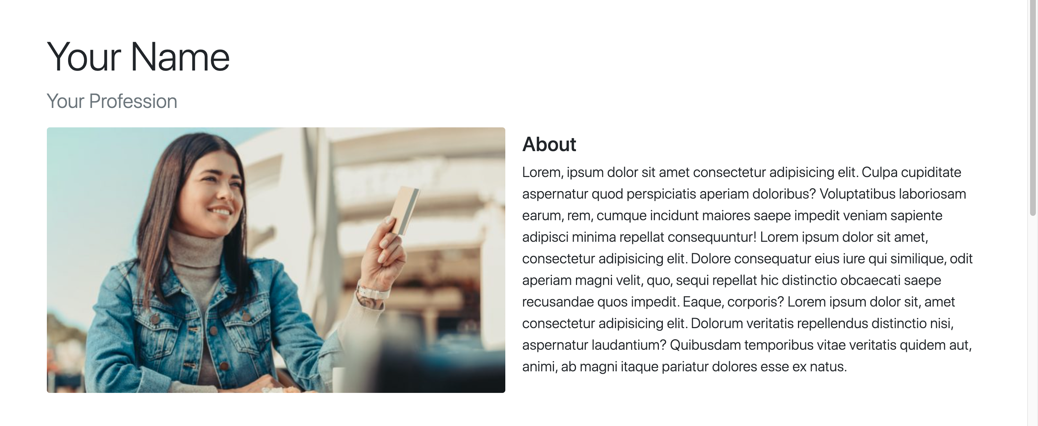
Introduction Section

Slide 4
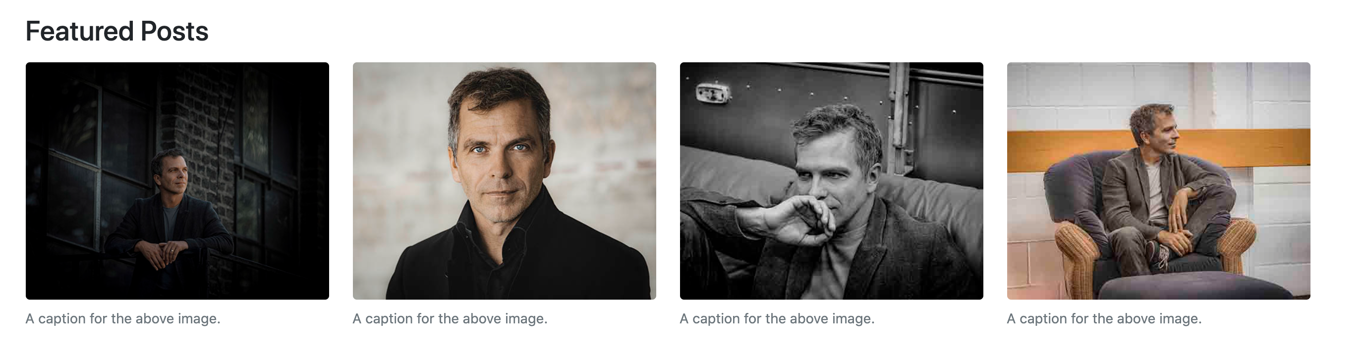
Featured posts

Slide 5
Featured posts
First thing we will do as usual is the container or container fluid. Then, we will add
<h3 class="mt-5 mb-3">Featured Posts</h3>
Secondly, do you remember what we can use inside bootstrap that has caption like these? The figures: https://getbootstrap.com/docs/5.1/content/figures/
We will add <div class="row"> </div> and every figure will have <div class="col-lg-3 col-6"></div>
This means that the width of the large screen can take up to 12/3 = 4 figures. If we add more, the layout will be broken. Smaller than this screen, we will see two columns in the row because 12/6 = 2.

Slide 6
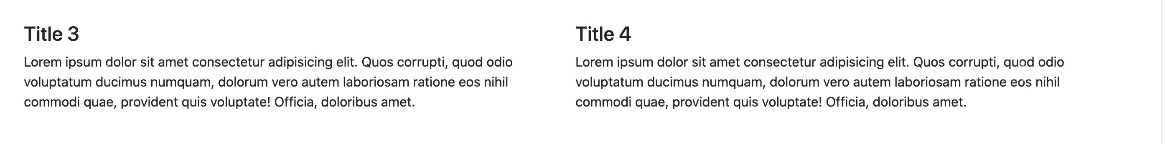
Carousel

Slide 7
Carousel
We can checkout this carousel: https://getbootstrap.com/docs/5.1/components/carousel/#with-controls
The main difference, in the screenshot we have text but in the link we have image.
The purpose of this carousel is to know that I can add even a grid system inside the carousel item.
For example, we have <div class="carousel-item active"> <img src="..." class="d-block w-100" alt="..."> </div> For our carousel, we will add <div class="row"> <div class="col-6"></div></div>
We don’t need containers because the carousel is already responsive

Slide 8
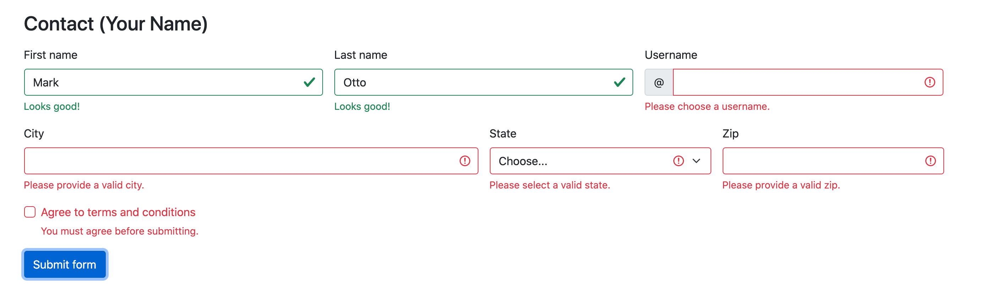
Contact Form

Slide 9
Contact Form
For this contact form, we can add the JS for the validation. Then we can add required inputs, invalid and valid feedback

Slide 10
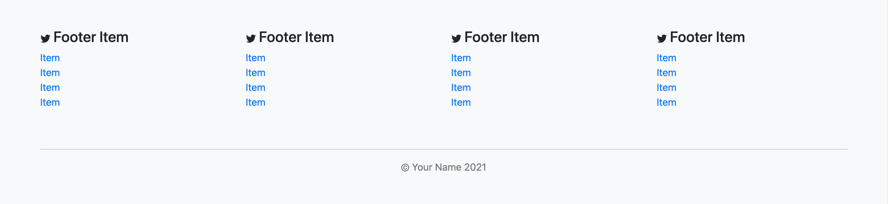
Footer

Slide 11
Footer
First thing we have here is <footer>. Then we have container to make sure that there will not be x-axis scrolling because of the responsive design of the grid system.
Secondly, <div class="row align-items-center justify-content-center justify-content-lg-start">
Thirdly, <div class="col-lg-3 col-6">

Slide 12
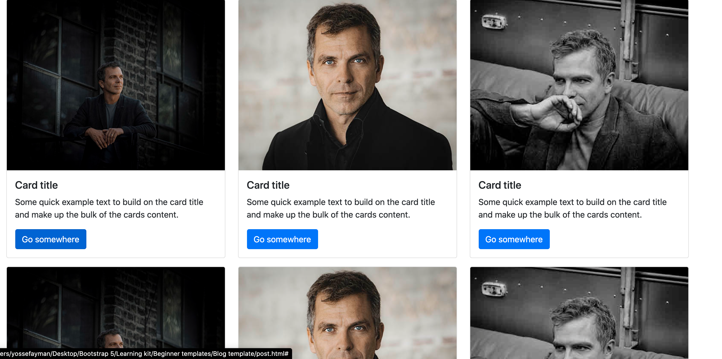
Popular posts

Slide 13
Popular posts
Multiple rows, same width and they consist of cards.
We will add container, <h1 class="display-6 mb-3">Popular posts</h1>.
Secondly, we will add <div class="row">.
Thirdly, <div class="col-md-4 col-6 mb-3">. Then the cards with its content from: https://getbootstrap.com/docs/5.1/components/card/#example

Slide 14
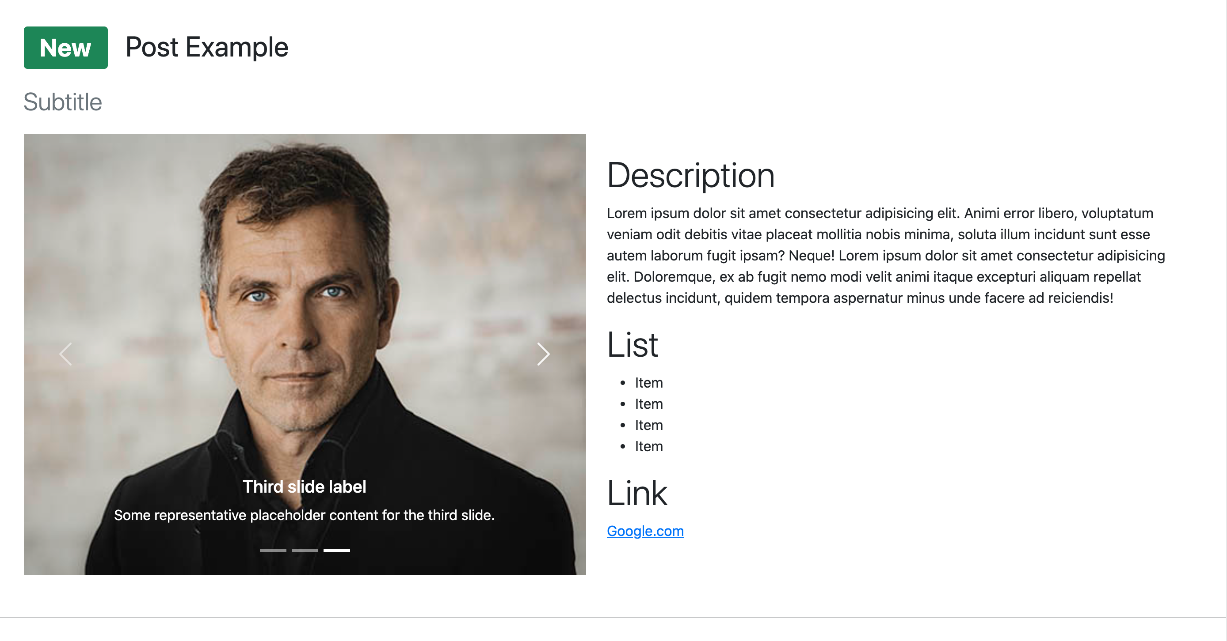
Post Example

Slide 15
Post Example
As usual, container or container-fluid.
We can see a badge, we will add <span class="badge fs-3 bg-success">New</span>
<span class="fs-2 ms-3">Post Example</span> To avoid using grid system for this sentence.
We will use <div class="w-100"></div> to break the line instead of <br>.
<p class="lead mt-3 text-muted fs-3">Subtitle</p>
Then, we will use grid system, two col-md-6. One for the carousel and one for the content.
Carousel: https://getbootstrap.com/docs/5.1/components/carousel/#with-indicators

Slide 16
Related posts
Same concept of featured posts

